Slide 1
S-04 To fix boot failure after capsule firmware update
NVL-S
Suggested Rework Document

Slide 2
S-04
To fix boot failure after capsule firmware update
Change Log | 2025 WW37.3 : Initialized
Description | When we execute capsule update, the last step is EC reset. Now EC reset will only assert PCH_PWROK and RSMRST_N to low, but we have to also assert PCH_DPWROK for a complete reset sequence, or the system will be stuck.
Impact | Without this rework, system will be stuck at EC01 after executing EC reset.
Rework Involved | SMD Resistors
SKUs | All NVL-S RVPs
Contacts | Lin, Nick1 ; Wang, Ivan B; Liu, Yuan Erh
HSD Link | https://hsdes.intel.com/appstore/article-one/#/article/16028338641
Collateral Link | N/A
SW Dependency | EC FW that has the following RCR implemented https://hsdes.intel.com/appstore/article-one/#/article/15018332657

Slide 3
S01x/S02x

Slide 4
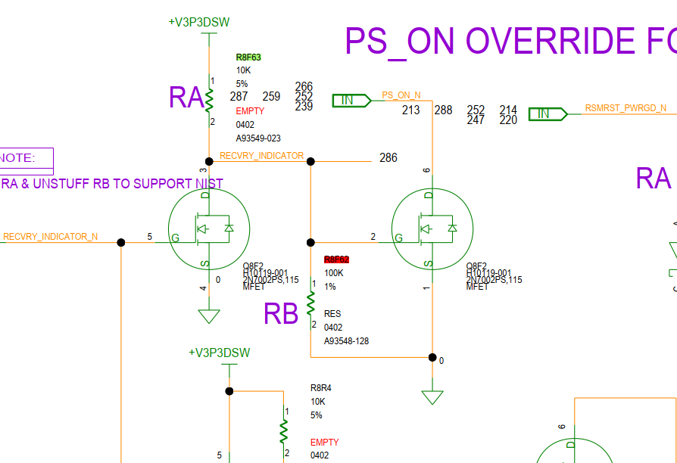
NVL-S S01x/S02x TOP

Slide 5
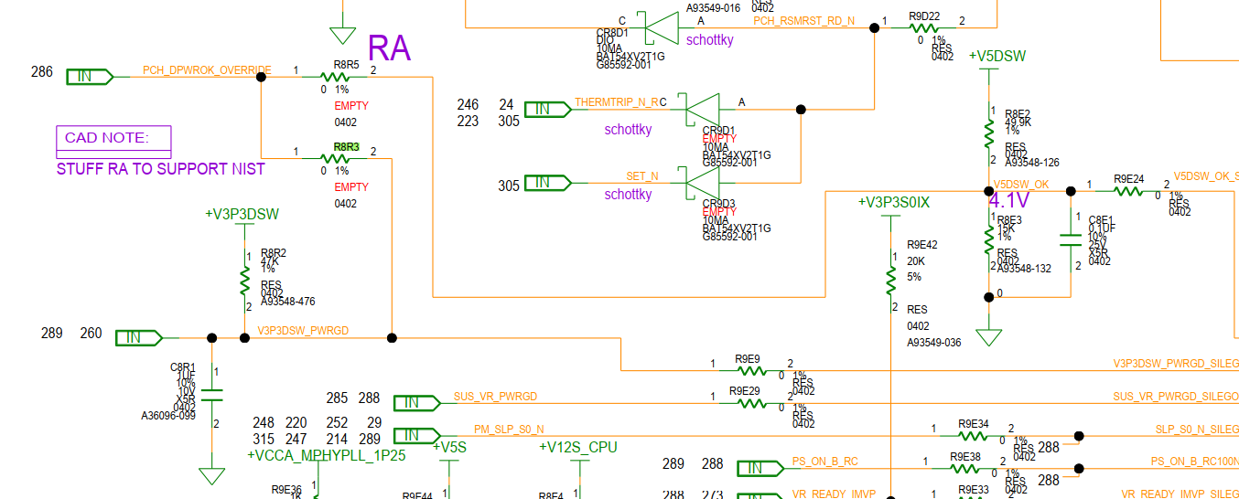
NVL-S S01x/S02x BOT

Slide 6
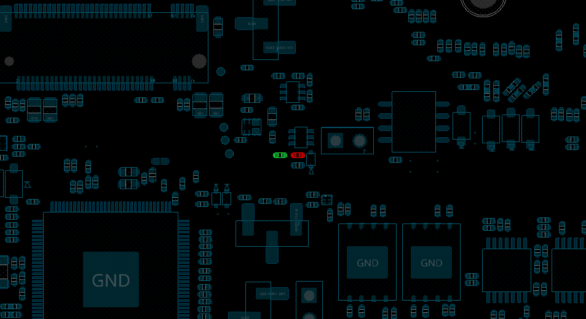
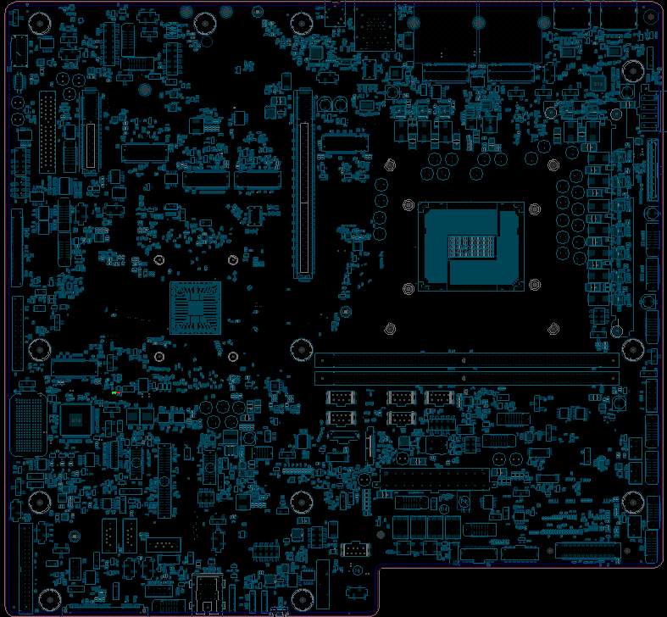
NVL-S S01x/S02x
Step 1 of 2
Action | REFDES | Description
STUFF | R8F63 | RES D,0402,10.00 kOHM,5.00%,1/16W
UNSTUFF | R8F62 | NA
R8F63
R8F62
TOP

Slide 7
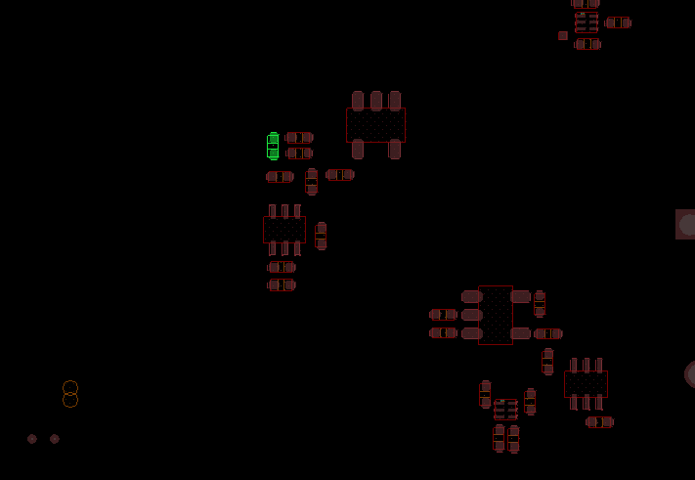
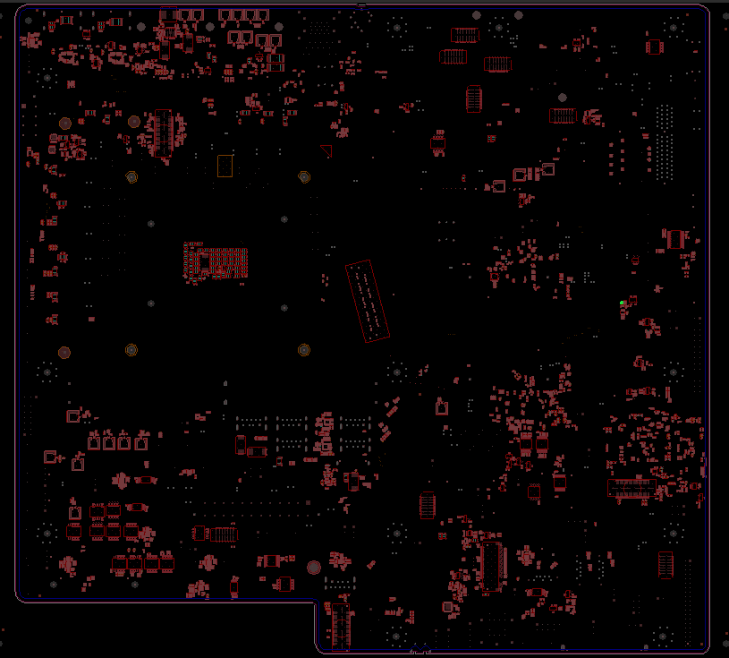
NVL-S S01x/S02x
Step 2 of 2
Action | REFDES | Description
STUFF | R8R3 | RES D,0402,0 OHM,5.00%,1/16W
R8R3
BOT

Slide 8
NVL-S S01x/S02x
S-04 To fix boot gating issue after executing EC reset
Action | Item | REFDES | Current IPN | Description | New IPN | Description
STUFF | Resistor | R8F63 | N/A | N/A | A93549-023 | RES D,0402,10.00 kOHM,5.00%,1/16W
UNSTUFF | Resistor | R8F62 | A93548-128 | RES D,0402,100.00 kOHM,1.00%,1/16W | NA | NA
STUFF | Resistor | R8R3 | N/A | N/A | A93549-001 | RES D,0402,0.00 OHM,5.00%,1/16W

Slide 9
S031

Slide 10
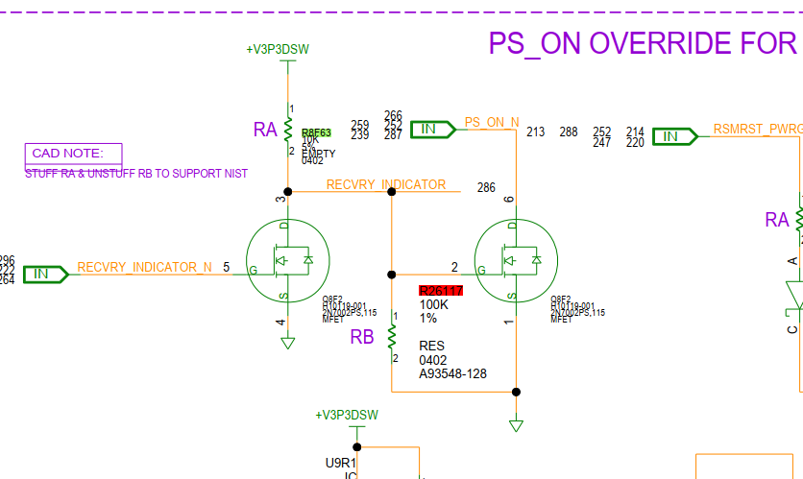
NVL-S S031 TOP

Slide 11
NVL-S S031 BOT

Slide 12
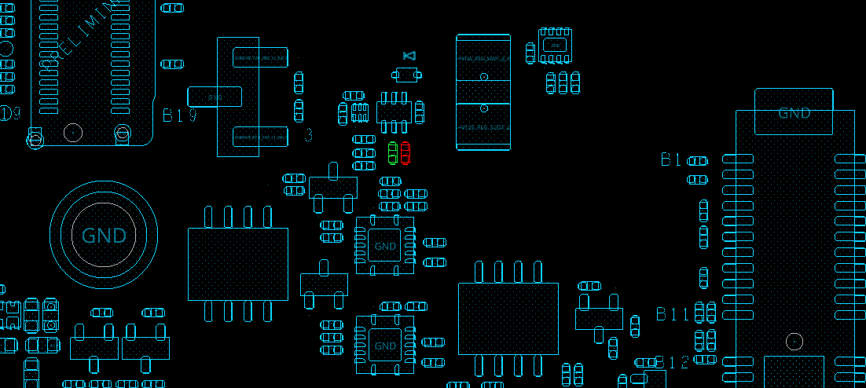
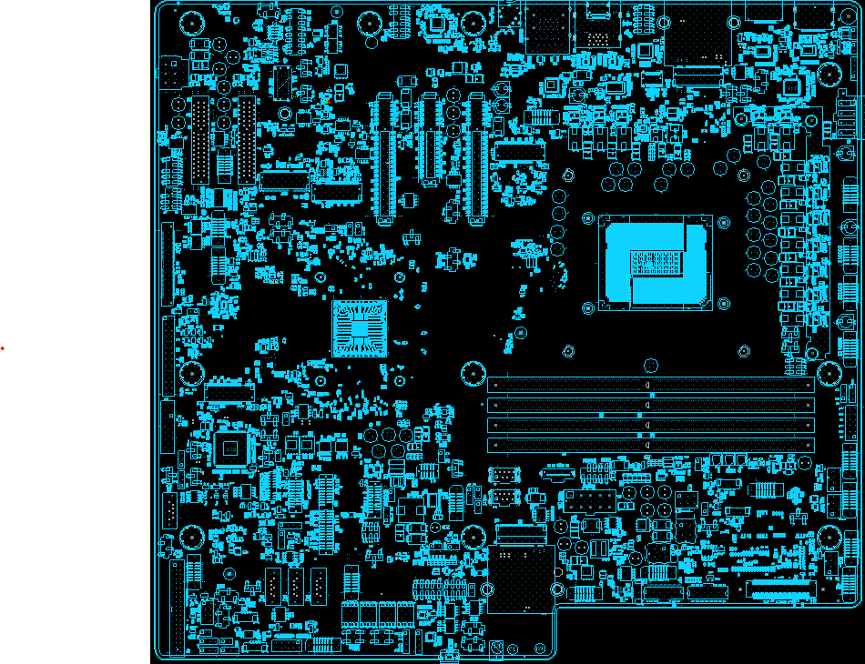
NVL-S S031
Step 1 of 2
Action | REFDES | Description
STUFF | R8F63 | RES D,0402,10.00 kOHM,5.00%,1/16W
UNSTUFF | R26117 | NA
R8F63
R26117
TOP

Slide 13
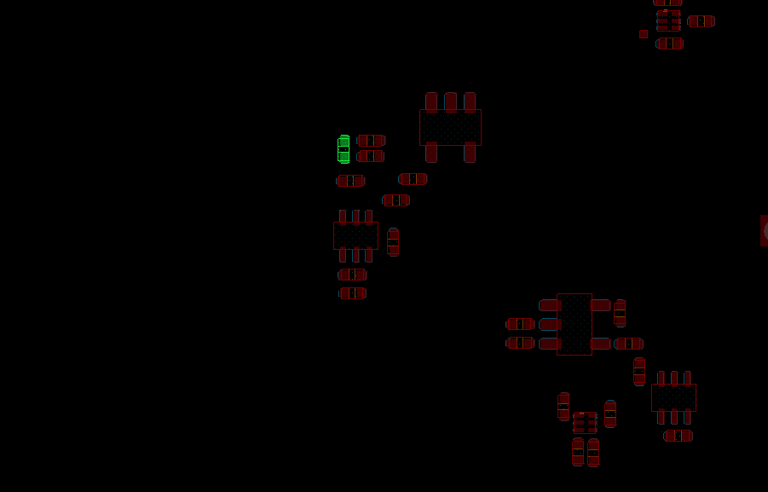
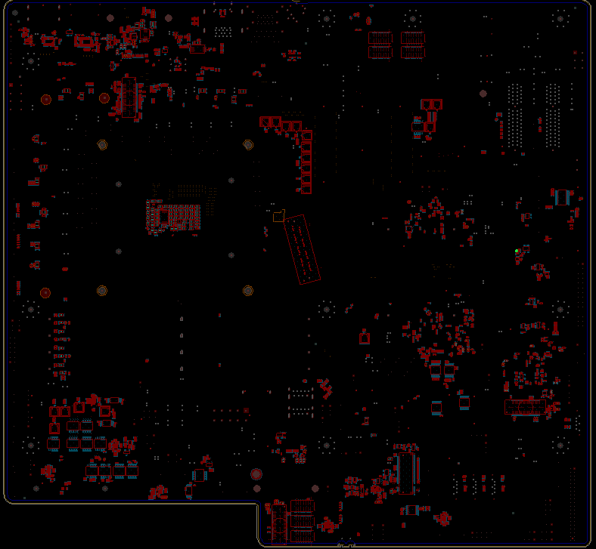
NVL-S S31
Step 2 of 2
Action | REFDES | Description
STUFF | R8R3 | RES D,0402,0 OHM,5.00%,1/16W
R8R3
BOT

Slide 14
NVL-S S031
S-04 To fix boot gating issue after executing EC reset
Action | Item | REFDES | Current IPN | Description | New IPN | Description
STUFF | Resistor | R8F63 | N/A | N/A | A93549-023 | RES D,0402,10.00 kOHM,5.00%,1/16W
UNSTUFF | Resistor | R26117 | A93548-128 | RES D,0402,100.00 kOHM,1.00%,1/16W | NA | NA
STUFF | Resistor | R8R3 | N/A | N/A | A93549-001 | RES D,0402,0.00 OHM,5.00%,1/16W

Slide 15
S041

Slide 16
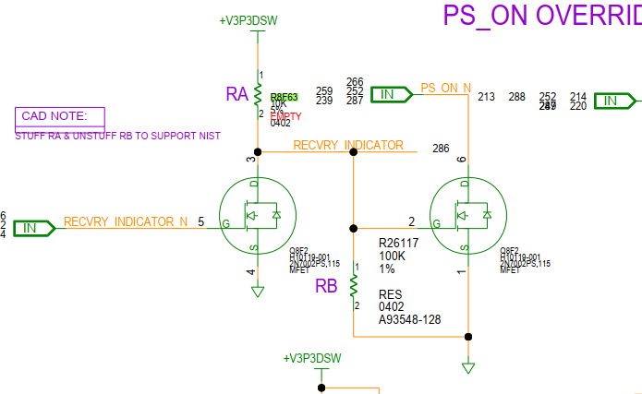
NVL-S S041 TOP

Slide 17
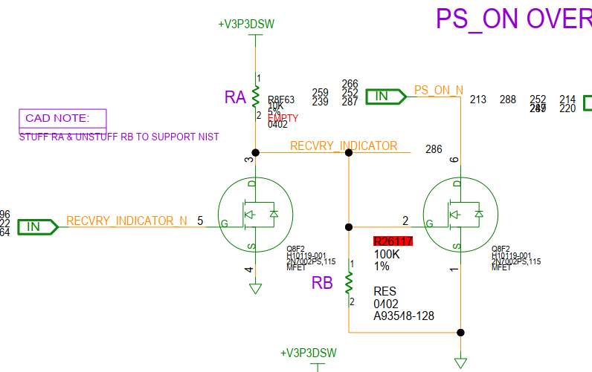
NVL-S S041 BOT

Slide 18
NVL-S S041 BOT

Slide 19

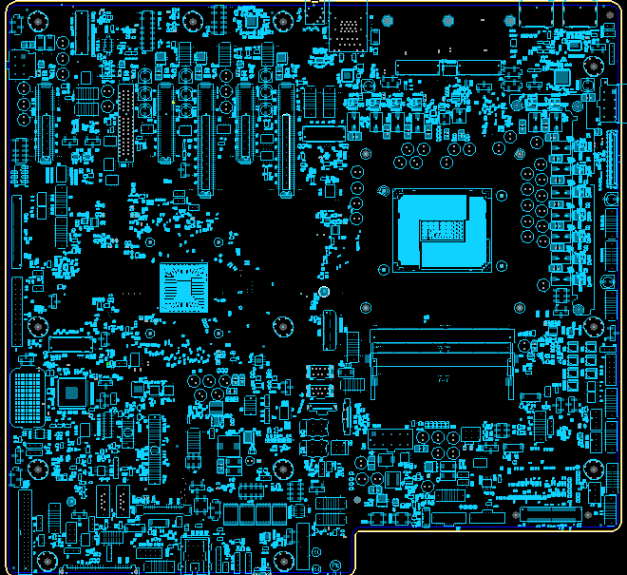
NVL-S S041
Step 1 of 2
Action | REFDES | Description
STUFF | R8F63 | RES D,0402,10.00 kOHM,5.00%,1/16W
R8F63
TOP

Slide 20
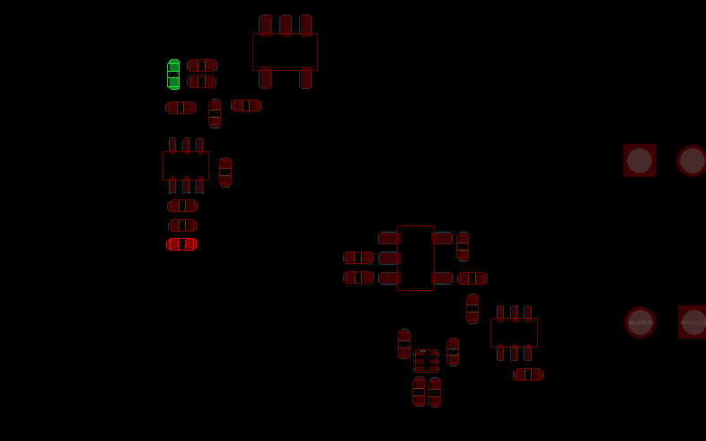
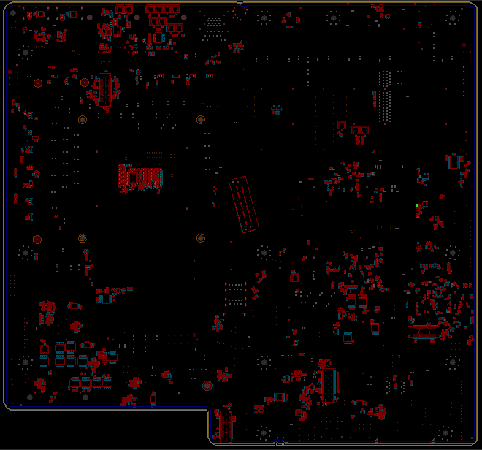
NVL-S S041
Step 2 of 2
R8R3
Action | REFDES | Description
UNSTUFF | R26117 | RES D,0402,0 OHM,5.00%,1/16W
STUFF | R8R3 | RES D,0402,0 OHM,5.00%,1/16W
R26117
BOT

Slide 21
NVL-S S041
S-04 To fix boot gating issue after executing EC reset
Action | Item | REFDES | Current IPN | Description | New IPN | Description
STUFF | Resistor | R8F63 | N/A | N/A | A93549-023 | RES D,0402,10.00 kOHM,5.00%,1/16W
UNSTUFF | Resistor | R26117 | A93548-128 | RES D,0402,100.00 kOHM,1.00%,1/16W | NA | NA
STUFF | Resistor | R8R3 | N/A | N/A | A93549-001 | RES D,0402,0.00 OHM,5.00%,1/16W

Slide 22
S051

Slide 23
NVL-S S051 TOP

Slide 24
NVL-S S051 BOT

Slide 25
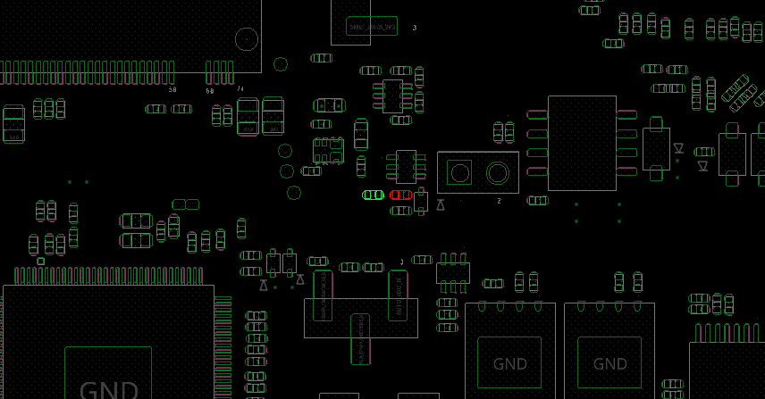
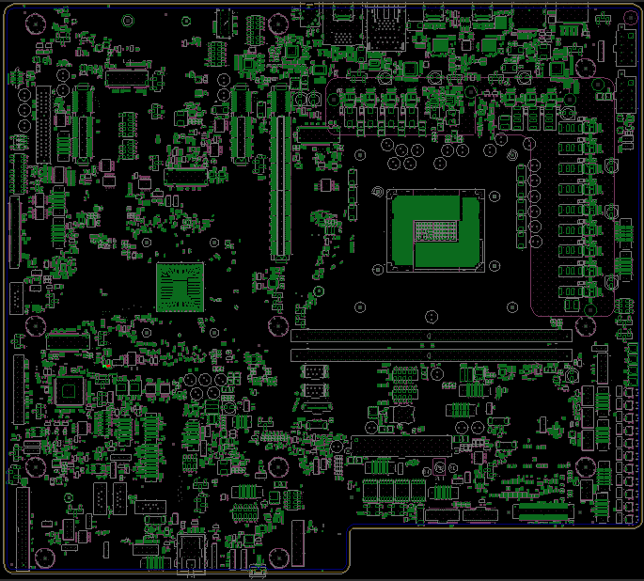
NVL-S S051
Step 1 of 2
Action | REFDES | Description
STUFF | R8F63 | RES D,0402,10.00 kOHM,5.00%,1/16W
UNSTUFF | R8F62 | NA
R8F63
R8F62
TOP

Slide 26
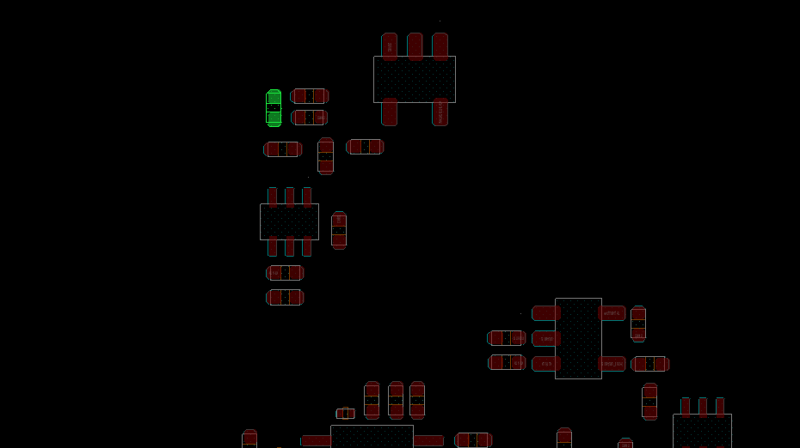
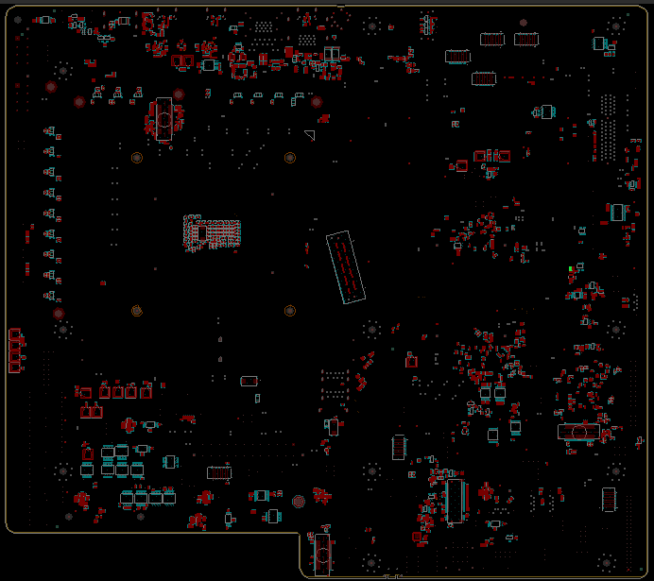
NVL-S S051
Step 2 of 2
R8R3
Action | REFDES | Description
STUFF | R8R3 | RES D,0402,0 OHM,5.00%,1/16W
BOT

Slide 27
NVL-S S051
S-04 To fix boot gating issue after executing EC reset
Action | Item | REFDES | Current IPN | Description | New IPN | Description
STUFF | Resistor | R8F63 | N/A | N/A | A93549-023 | RES D,0402,10.00 kOHM,5.00%,1/16W
UNSTUFF | Resistor | R8F62 | A93548-128 | RES D,0402,100.00 kOHM,1.00%,1/16W | NA | NA
STUFF | Resistor | R8R3 | N/A | N/A | A93549-001 | RES D,0402,0.00 OHM,5.00%,1/16W

Slide 28
S061

Slide 29
NVL-S S061 TOP

Slide 30
NVL-S S061 TOP

Slide 31
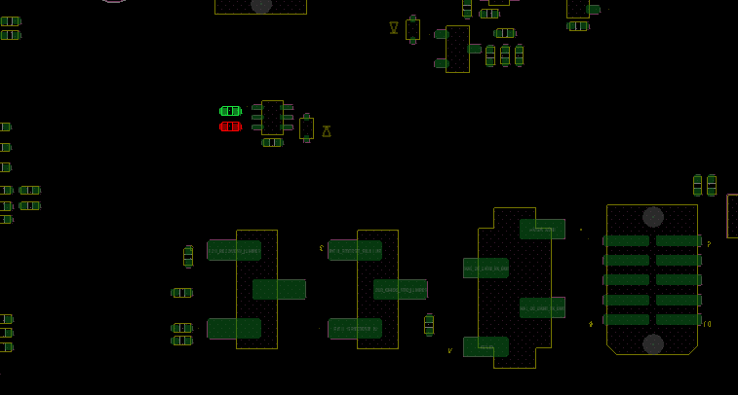
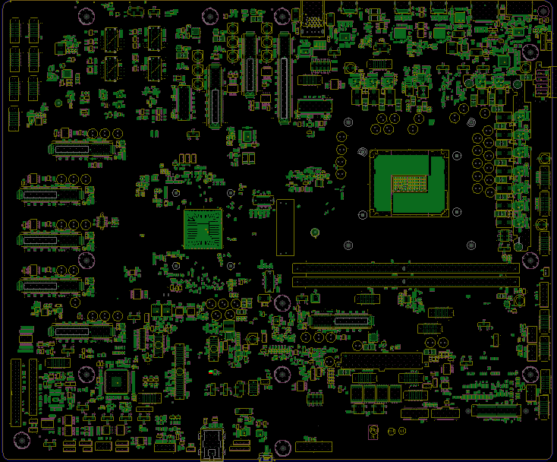
NVL-S S061
Step 1 of 2
Action | REFDES | Description
STUFF | R8F63 | RES D,0402,10.00 kOHM,5.00%,1/16W
UNSTUFF | R8F62 | NA
R8F63
R8F62
TOP

Slide 32
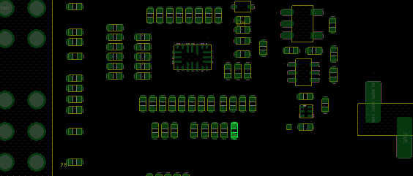
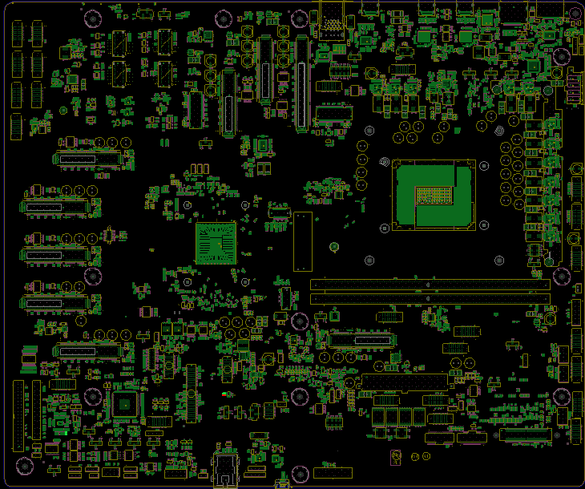
NVL-S S061
Step 2 of 2
Action | REFDES | Description
STUFF | R8R3 | RES D,0402,0 OHM,5.00%,1/16W
R8R3
TOP

Slide 33
NVL-S S061
S-04 To fix boot gating issue after executing EC reset
Action | Item | REFDES | Current IPN | Description | New IPN | Description
STUFF | Resistor | R8F63 | N/A | N/A | A93549-023 | RES D,0402,10.00 kOHM,5.00%,1/16W
UNSTUFF | Resistor | R8F62 | A93548-128 | RES D,0402,100.00 kOHM,1.00%,1/16W | NA | NA
STUFF | Resistor | R8R3 | N/A | N/A | A93549-001 | RES D,0402,0.00 OHM,5.00%,1/16W

